Slide 1


Jeremy Harkness
21 September 2023

Slide 2

Outline
Executive Summary
Introduction
Methodology
Results
Conclusion
Appendix

Slide 3

Executive Summary
We analyze Falcon 9 first-stage landings data to determine the likelihood of a successful landing.
Methodologies:
- Data collection involved SpaceX REST API and web scraping for past launches.
- Data wrangling focused on improving data quality and filtering Falcon 1 launches.
- EDA revealed correlations between launch site, payload mass, and successful landings.
- Interactive visual analytics using Folium and Plotly Dash showcased launch site proximity.
- Predictive analysis utilized SVM, Classification Trees, and Logistic Regression.
Key Findings:
1. Launch site selection, payload mass, and mission success rates impact successful landings.
2. Interactive visualizations provide valuable understanding of optimal launch sites.
3. Predictive models assist in predicting successful landings accurately.
Implications:
1. Informed decision-making regarding cost-effectiveness and reusability of Falcon 9.
2. Identified crucial factors for successful first-stage landings .
3. Potential for increased competition in the space launch market.
Notes:
Summary of methodologies

Slide 4
Introduction
Background: Rapid expansion of commercial space travel, and the emergence of SpaceY, as new competitor, requires understanding of costs and reliability of reusable rockets.
Determine Falcon 9 Launch Cost Estimation
Gather SpaceX cost data.
Develop cost estimation models.
Create informative dashboards.
First Stage Reusability Prediction
Utilize machine learning.
Analyze public information.
Forecast Falcon 9 first stage reusability.
Notes:
Project background and context
Problems you want to find answers

Slide 5

Section 1

Slide 6

Methodology
Data collection methodology:
Utilized SpaceX REST API to gather past launch data
Implemented web scraping techniques to extract Falcon 9 launch records from HTML tables
Data wrangling:
Handled null values and missing data
Filtered out Falcon 1 launches to focus on Falcon 9 data
Transformed the data into a clean and structured format
Notes:
Data collection methodology:
Describe how data was collected
Perform data wrangling
Describe how data was processed
Perform exploratory data analysis (EDA) using visualization and SQL
Perform interactive visual analytics using Folium and Plotly Dash
Perform predictive analysis using classification models
How to build, tune, evaluate classification models

Slide 7
Methodology
Data processing:
Cleaned and organized the data to ensure quality
Filled in missing values and removed irrelevant data
Exploratory data analysis (EDA) using visualization and SQL:
Used visualization techniques to uncover patterns and trends in the data
Employed SQL queries for deeper analysis and extract specific information
Interactive visual analytics using Folium and Plotly Dash:
Created interactive Folium maps for launch site locations and proximity
Used Plotly Dash to build interactive dashboards for dynamic exploration

Slide 8
Methodology
Predictive analysis using classification models:
Built classification models (e.g. Support Vector Machines, Classification Trees, Logistic Regression)
Split the data into training and test sets
Tuned hyperparameters to optimize model performance using techniques like grid search or randomized search
How to build, tune, evaluate classification models:
Constructed classification models by training them on the training set
Tuned the models' hyperparameters to improve their performance
Evaluated the models using metrics such as accuracy, precision, recall, and F1 score
Selected the best-performing model for predicting the success of Falcon 9 first-stage landings

Slide 9
Data Collection
Method 1: SpaceX API Data Collection
Objective: To collect and format data from an API to predict the success of Falcon 9 first stage landings.
Steps:
Identifying the necessary API endpoints.
Making API calls to collect data.
Formatting and structuring the collected data for analysis.
Tools: Python, SpaceX API - https://api.spacexdata.com/v4/launches/past.
Method 2: Web Scraping
Objective: To scrape Falcon 9 and Falcon Heavy launch records from a Wikipedia page.
Steps:
Identifying the Wikipedia page with the necessary data.
Utilizing web scraping techniques to extract data.
Cleaning and formatting the scraped data for analysis.
Tools: Python, BeautifulSoup library.
Source: Wikipedia page https://api.spacexdata.com/v4/launches/past
Notes:
Describe how data sets were collected.
You need to present your data collection process use key phrases and flowcharts

Slide 10
Data Collection – SpaceX API
Using the 'requests' library with appropriate function calls, we populate the global variables with the data from the SpaceX REST endpoints.
The GitHub URL of the completed SpaceX API calls notebook
jupyter-labs-spacex-data-collection-api.ipynb
Start
create
global Variables
getBoosterVersion
getLaunchSite
getPayloadData
End
Create
df_launch_dict
getCoreData
create launch_dict
https://github.com/jeremyharkness/Applied-Data-Science-Capstone/blob/main/Week-1-Introduction/10%20-%20App%20Item%C2%A0-%20Hands-on%20Lab%20-%20Complete%20the%20Data%20Collection%20API%20Lab/jupyter-labs-spacex-data-collection-api.ipynb
Notes:
https://github.com/jeremyharkness/Applied-Data-Science-Capstone/blob/main/Week-1-Introduction/10%20-%20App%20Item%C2%A0-%20Hands-on%20Lab%20-%20Complete%20the%20Data%20Collection%20API%20Lab/jupyter-labs-spacex-data-collection-api.ipynb

Slide 11
Data Collection - Scraping
Using the 'BeautifulSoup' library with appropriate function calls, we populate the global variables with the data from a snapshot of the SpaceX Wikipedia Wiki.
The GitHub URL of the completed SpaceX API calls notebook
jupyter-labs-webscraping.ipynb
Start
create
global Variables
booster_version
landing_status
get_mass
End
Create
df_launch_dict
extract_column_from_header
create launch_dict
https://github.com/jeremyharkness/Applied-Data-Science-Capstone/blob/main/Week-1-Introduction/12%20-%20App%20Item%C2%A0-%20Hands-on%20Lab%20-%20Complete%20the%20Data%20Collection%20with%20Web%20Scraping%20lab/jupyter-labs-webscraping.ipynb
Notes:
https://github.com/jeremyharkness/Applied-Data-Science-Capstone/blob/main/Week-1-Introduction/12%20-%20App%20Item%C2%A0-%20Hands-on%20Lab%20-%20Complete%20the%20Data%20Collection%20with%20Web%20Scraping%20lab/jupyter-labs-webscraping.ipynb
Present your web scraping process using key phrases and flowcharts
Add the GitHub URL of the completed web scraping notebook, as an external reference and peer-review purpose

Slide 12
Data Wrangling
Check for missing values & view data types
df.isnull().sum() & df.dtypes
Get the value counts of the columns
df['LaunchSite'].value_counts()
df['Orbit'].value_counts()
df['Outcome'].value_counts()
Identify & group bad outcomes into a set
Create column "Class" to classify outcomes. 0 for bad , & 1 for good outcomes.
labs-jupyter-spacex-data_wrangling.ipynb
Start
Read CSV file from URL into Data Frame
Initial Data Exploration
Display first 10 rows
Check for missing values
Check data types of columns
Value Counts
Get value counts of "LaunchSite"
Get value counts of "Orbit"
Get unique values and their counts in "Outcome"
End
Data Export to a new CSV file
Outcome Classification
Identify bad outcomes
Create "Class" column for outcome classification
Calculate success rate
https://github.com/jeremyharkness/Applied-Data-Science-Capstone/blob/main/Week-1-Introduction/16%20-%20App%20Item%C2%A0-%20Hands-on%20Lab%20-%20Data%20Wrangling/labs-jupyter-spacex-data_wrangling.ipynb
Notes:
https://github.com/jeremyharkness/Applied-Data-Science-Capstone/blob/main/Week-1-Introduction/16%20-%20App%20Item%C2%A0-%20Hands-on%20Lab%20-%20Data%20Wrangling/labs-jupyter-spacex-data_wrangling.ipynb
Describe how data were processed
You need to present your data wrangling process using key phrases and flowcharts
Add the GitHub URL of your completed data wrangling related notebooks, as an external reference and peer-review purpose

Slide 13
EDA with Data Visualization
Task 1: Scatter Plot - Visualize the relationship between 'flight number' and 'launch site'.
Task 2: Scatter Plot - Analyze the relationship between the 'payload mass' (in kg) and the 'launch site'.
Task 3: Bar Chart - Visualize the relationship between success rate of each 'orbit type'.
Task 4: Scatter Plot - Visualizes the distribution of different 'orbit types'' over the flight numbers'.
Task 5: Scatter Plot - Visualize the relationship between the payload mass and the orbit type.
Task 6: Line Plot - Visualize the trend of launch success over the years.
Final notebook jupyter-labs-eda-dataviz.ipynb
Notes:
Summarize what charts were plotted and why you used those charts
Add the GitHub URL of your completed EDA with data visualization notebook, as an external reference and peer-review purpose

Slide 14
EDA with SQL
Task 1: Display the names of the unique launch sites in the space mission.
Selecting distinct values from the "Launch_Site" column in the SPACEXTABLE.
SQL Query: %sql SELECT DISTINCT "Launch_Site" FROM SPACEXTABLE
Task 2: Display 5 records where launch sites begin with the string 'CCA'.
Selecting all columns from SPACEXTABLE.
Filtering rows to include only those where the "Launch_Site" column starts with 'CCA'.
Limiting the output to the first 5 rows.
SQL Query: %sql SELECT * FROM SPACEXTABLE WHERE "Launch_Site" LIKE 'CCA%' LIMIT 5

Slide 15
EDA with SQL
Task 3: Display the total payload mass carried by boosters launched by NASA (CRS).
Calculating the sum of the values in the "PAYLOAD_MASS__KG_" column.
Filtering the rows where the "Customer" column starts with 'NASA (CRS)'.
SQL Query: %sql SELECT SUM("PAYLOAD_MASS__KG_") FROM SPACEXTABLE WHERE "Customer" LIKE 'NASA (CRS)%'
Task 4: Display the average payload mass carried by booster version F9 v1.1.
Calculating the average of the values in the "PAYLOAD_MASS__KG_" column.
Filtering the rows where the "Booster_Version" column starts with 'F9 v1.1'.
SQL Query: %sql SELECT AVG("PAYLOAD_MASS__KG_") FROM SPACEXTABLE WHERE "Booster_Version" like 'F9 v1.1%'

Slide 16
EDA with SQL
Task 5: List the date when the first successful landing on the ground pad was achieved.
Finding the minimum date in the "Date" column.
Filtering the rows where the "Landing_Outcome" column starts with 'Success (ground pad)'.
SQL Query: %sql SELECT MIN("Date") FROM SPACEXTABLE WHERE "Landing_Outcome" LIKE 'Success (ground pad)%'

Slide 17
EDA with SQL
Task 6: List the names of the boosters which have success landing on a drone ship and have a payload mass greater than 4000 but less than 6000.
Selecting the "Booster_Version" column.
Filtering the rows where:
The "Landing_Outcome" column starts with 'Success (drone ship)'.
The "PAYLOAD_MASS__KG_" column has values between 4000 and 6000.
SQL Query: %sql SELECT "Booster_Version" FROM SPACEXTABLE WHERE "Landing_Outcome" LIKE 'Success (drone ship)%' AND "PAYLOAD_MASS__KG_" BETWEEN 4000 AND 6000;

Slide 18
EDA with SQL
Task 7: List the total number of successful and failure mission outcomes.
Creating a new column "Mission_Result" based on the "Mission_Outcome" column values.
Counting the number of occurrences of each "Mission_Result".
Grouping the results by the "Mission_Result" column.
SQL Query: %sql SELECT CASE WHEN "Mission_Outcome" LIKE 'Success%' THEN 'Success' ELSE 'Failure' END AS "Mission_Result", COUNT("Mission_Outcome") FROM SPACEXTABLE GROUP BY "Mission_Result";

Slide 19
EDA with SQL
Task 8: List the names of the booster versions which have carried the maximum payload mass (using a subquery).
Selecting the "Booster_Version" column.
Filtering the rows where the "PAYLOAD_MASS__KG_" column equals the maximum value in the "PAYLOAD_MASS__KG_" column in the SPACEXTABLE.
SQL Query: %sql SELECT "Booster_Version" FROM SPACEXTABLE WHERE "PAYLOAD_MASS__KG_" = (SELECT MAX("PAYLOAD_MASS__KG_") FROM SPACEXTABLE);

Slide 20
EDA with SQL
Task 9: List the records which will display the month names, failure landing outcomes in drone ship, booster versions, launch site for the months in the year 2015. Creating a new column "Month" to represent the month name.
Selecting the "Landing_Outcome", "Booster_Version", and "Launch_Site" columns.
Filtering the rows where:
The "Landing_Outcome" column starts with 'Failure (drone ship)'.
The year extracted from the "Date" column equals '2015'.
SQL Query: %sql SELECT "month_name" AS Month, "Landing_Outcome", "Booster_Version", "Launch_Site" \ FROM SPACEXTABLE \ WHERE "Landing_Outcome" LIKE 'Failure (drone ship)%' AND substr("Date", 1, 4) = '2015';

Slide 21
EDA with SQL
Task 10: Rank the count of landing outcomes (such as Failure (drone ship) or Success (ground pad)) between the dates 2010-06-04 and 2017-03-20, in descending order.
Selecting the "Landing_Outcome" column and counting the number of occurrences of each "Landing_Outcome".
Filtering the rows where the "Date" column falls between '2010-06-04' and '2017-03-20'.
Grouping the results by the "Landing_Outcome" column.
Ordering the results in descending order based on the count of "Landing_Outcome".
SQL Query: %sql SELECT "Landing_Outcome", COUNT("Landing_Outcome") AS Count FROM SPACEXTABLE WHERE "Date" BETWEEN '2010-06-04' AND '2017-03-20' GROUP BY "Landing_Outcome" ORDER BY Count DESC;

Slide 22
EDA with SQL
Add the GitHub URL of your completed EDA with SQL notebook.
jupyter-labs-eda-sql-coursera_sqllite.ipynb
https://github.com/jeremyharkness/Applied-Data-Science-Capstone/blob/main/Week-2%20-%20Exploratory%20Data%20Analysis%20-%20EDA/02%20-%20App%20Item%C2%A0-%20Hands-on%20Lab%20-%20Complete%20the%20EDA%20with%20SQL/jupyter-labs-eda-sql-coursera_sqllite.ipynb
Notes:
https://github.com/jeremyharkness/Applied-Data-Science-Capstone/blob/main/Week-2%20-%20Exploratory%20Data%20Analysis%20-%20EDA/02%20-%20App%20Item%C2%A0-%20Hands-on%20Lab%20-%20Complete%20the%20EDA%20with%20SQL/jupyter-labs-eda-sql-coursera_sqllite.ipynb
Using bullet point format, summarize the SQL queries you performed
Add the GitHub URL of your completed EDA with SQL notebook, as an external reference and peer-review purpose

Slide 23
Build an Interactive Map with Folium
Task 1: Mark all launch sites on a map
Objective: - Visualize SpaceX launch sites on a map using coordinates.
Map Objects and Purpose:
Folium Map - Base map centered at NASA Johnson Space Center.
Folium Circle and Marker - Highlight NASA Johnson Space Center location.
Folium Circle and Marker (for each launch site) Mark and label launch sites to facilitate geographical analysis.

Slide 24
Build an Interactive Map with Folium
Task 2: Mark the success/failed launches for each site on the map
Objective: - Visualize launch outcomes (success/failure) at each SpaceX launch site.
Map Objects and Purpose:
Folium CircleMarker - Mark launch sites with popup labels.
Folium Circle (Green/Red) - Represent success/failure of launches, with radius indicating count.
Marker Cluster - Cluster markers for individual launches, color-coded for success (green) or failure (red).

Slide 25
Build an Interactive Map with Folium
Task 3: Calculate the distances between a launch site to its proximities
Objective: - Analyze proximities (like coastlines, cities) to launch sites by calculating and visualizing distances.
Map Objects and Purpose:
MousePosition Plugin - Help find coordinates of points of interest on the map.
Folium Marker - Mark points of interest and display distances from the launch site.
Folium PolyLine - Draw lines between the launch site and points to visually represent distances.
Add the GitHub URL of your completed interactive map with Folium lab_jupyter_launch_site_location.jupyterlite.ipynb
Notes:
Summarize what map objects such as markers, circles, lines, etc. you created and added to a folium map
Explain why you added those objects
Add the GitHub URL of your completed interactive map with Folium map, as an external reference and peer-review purpose

Slide 26
Build a Dashboard with Plotly Dash
Task 1:
A dropdown for selecting a launch site was added allowing users to interact with the dashboard by selecting a launch site to analyze.
A pie chart was added as a visual representation of the success rate of the launches from the selected site, helping users quickly grasp the performance of each site.

Slide 27
Build a Dashboard with Plotly Dash
Task 1:
A dropdown for selecting a launch site was added allowing users to interact with the dashboard by selecting a launch site to analyze.
A pie chart was added as a visual representation of the success rate of the launches from the selected site, helping users quickly grasp the performance of each site.
Task 2:
A slider to filter the payload mass was added, allowing users to focus on launches within a specific payload mass range, facilitating more detailed analysis.
A scatter plot was introduced to depict the correlation between payload and launch success for the selected launch site, offering insights into the optimal payload mass for successful launches.

Slide 28
Build a Dashboard with Plotly Dash
Task 3:
A scatter plot was integrated to visualize the success rate of each booster version, helping users to understand how different booster versions perform and identify the most and least successful versions.
Task 4:
A dropdown to select a range of dates for the launches was added, letting users analyze launches within a specific time frame, thus facilitating the focus on more recent launches or exploring historical performance.
The functionality to filter the scatter plot (from task 3) based on the selected date range was added, empowering users to identify potential trends or changes in performance over time, aiding in a more nuanced analysis.
Add the GitHub URL of your completed Plotly Dash lab spacex_dash_app_task4_completed.py
Notes:
https://github.com/jeremyharkness/Applied-Data-Science-Capstone/blob/main/Week-3%20-%20Interactive%20Visual%20Analytics%20and%20Dashboard/04%20-%20App%20Item%C2%A0-%20Hands-on%20Lab%20-%20Build%20an%20Interactive%20Dashboard%20with%20Ploty%20Dash/spacex_dash_app_task4_completed.py

Slide 29
Predictive Analysis (Classification)
Data Preparation
Loaded two datasets from specified URLs using asynchronous fetch requests
Tasks 1 & 2 - Created a NumPy array using the "Class" column
Standardized the feature set using StandardScaler
Data Splitting
Task 3 - Split the data into training (80%) testing (20%) sets using a random state of 2

Slide 30
Predictive Analysis (Classification)
Model Evaluation
Tasks - 5, 7, 9, and 11
For each of the models built in tasks 4, 6, 8, and 10, the accuracy on the test data was calculated using the score method
Visualized the performance using confusion matrices to understand the true positives, true negatives, false positives, and false negatives

Slide 31
Predictive Analysis (Classification)
Model Building and Hyperparameter Tuning
Task 4 - Built a logistic regression model using GridSearchCV with a 10-fold cross-validation to find the best hyperparameters from a specified grid
Task 6 - Applied a similar process for SVM, exploring various kernels and other parameters
Task 8 - Built a decision tree classifier exploring different criteria and depth levels
Task 10 - Applied k-Nearest Neighbors (KNN) classification, tuning the number of neighbors and the distance metric

Slide 32
Predictive Analysis (Classification)
Model Selection
Task 12 - Compared the accuracies of all the models on the test data
Identified the best performing model, which was found to be Logistic Regression with an accuracy of 83.33%

Slide 33
Predictive Analysis (Classification)
Key Phrases
Exploratory Data Analysis Data Standardization Training and Testing Split Hyperparameter Tuning Model Evaluation Confusion Matrix Analysis Best Model Selection
The GitHub URL of the completed SpaceX API calls notebook
SpaceX_Machine_Learning_Completed.ipynb
Data Preparation
Load datasets
Create a NumPy array
Standardize feature set
Split data into training and test sets
Model Building and Hyperparameter Tuning
ll Logistic Regression
Support Vector Machine
Decision Tree Classifier
k-Nearest Neighbors
Model Selection
Logistic Regression
accuracy of 83.33%
Model Evaluation
visualize performance using confusion matrices
https://github.com/jeremyharkness/Applied-Data-Science-Capstone/blob/main/Week-4%20-%20Predictive%20Analysis%20-%20Classification/02%20-%20App%20Item%C2%A0-%20Hands-on%20Lab%20-%20Complete%20the%20Machine%20Learning%20Prediction%20lab/SpaceX_Machine_Learning_Completed.ipynb
Notes:
Summarize how you built, evaluated, improved, and found the best performing classification model
You need present your model development process using key phrases and flowchart
Add the GitHub URL of your completed predictive analysis lab, as an external reference and peer-review purpose

Slide 34
Results
Exploratory data analysis results
Interactive analytics demo in screenshots
Predictive analysis results

Slide 35

Section 2

Slide 36
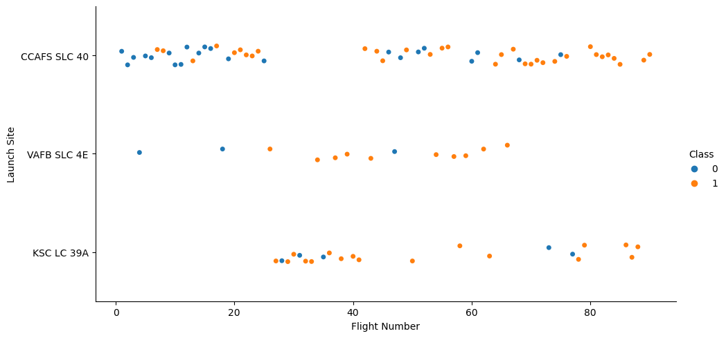
Flight Number vs. Launch Site
The plot allows for a deeper dive into each launch site to visualize its detailed launch records.
By observing the scatter points, we can identify patterns in flight numbers and their success rates at different launch sites
Notes:
Show a scatter plot of Flight Number vs. Launch Site
Show the screenshot of the scatter plot with explanations

Slide 37
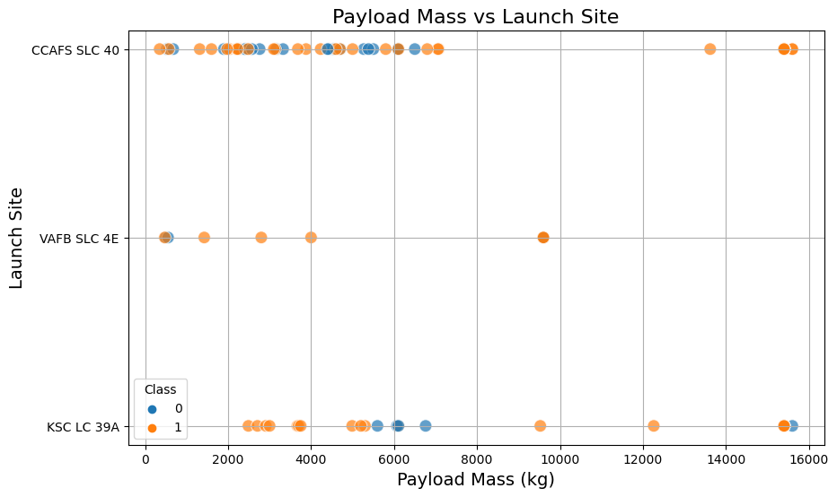
Payload vs. Launch Site
This plot visualizes the relationship between different launch sites and their payload mass.
We can observe that for the VAFB-SLC launch site, there are no rockets launched for heavy payload mass (greater than 10,000).
This suggests that certain launch sites might be preferred for specific payload mass ranges, potentially due to infrastructure or location constraints.

Slide 38
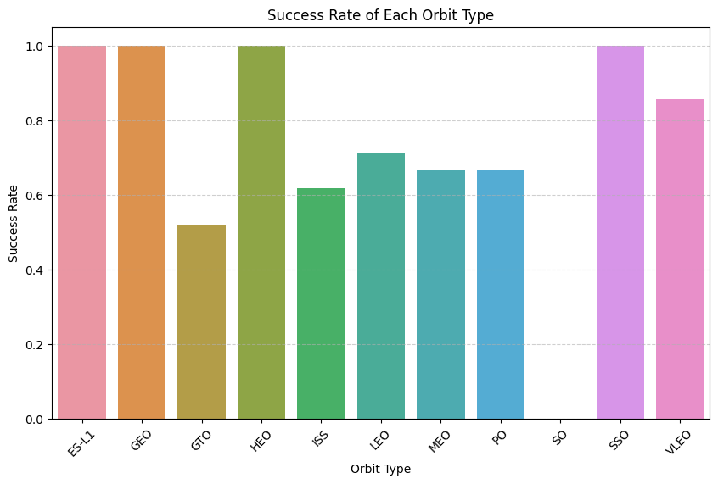
Success Rate vs. Orbit Type
This bar chart displays the success rate for each orbit.
It allows us to determine which orbits have a higher success rate.
By analyzing the bar chart, we can derive insights about the relationship between success rates and orbit types, which can be crucial for planning future launches.

Slide 39
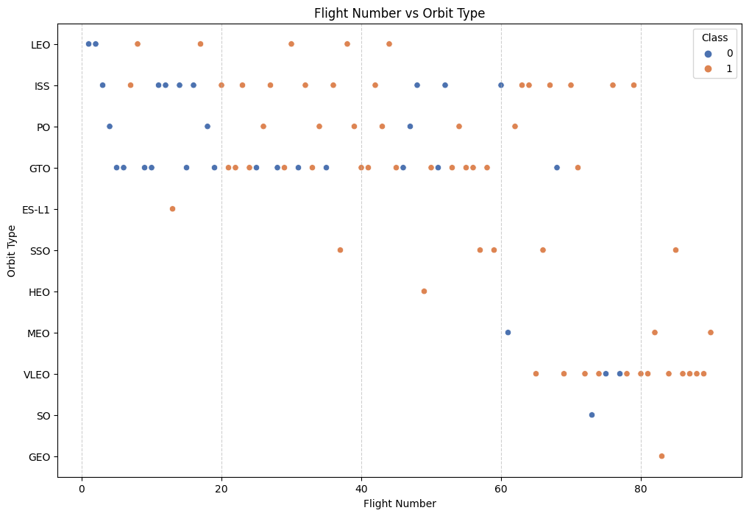
Flight Number vs. Orbit Type
This plot shows the relationship between FlightNumber and Orbit type.
In the LEO orbit, success appears to be related to the number of flights.
Conversely, for the GTO orbit, there seems to be no relationship between the flight number and success.
This plot helps in understanding how the success rate varies with the number of flights for different orbit types, which can be essential for risk assessment and planning.

Slide 40
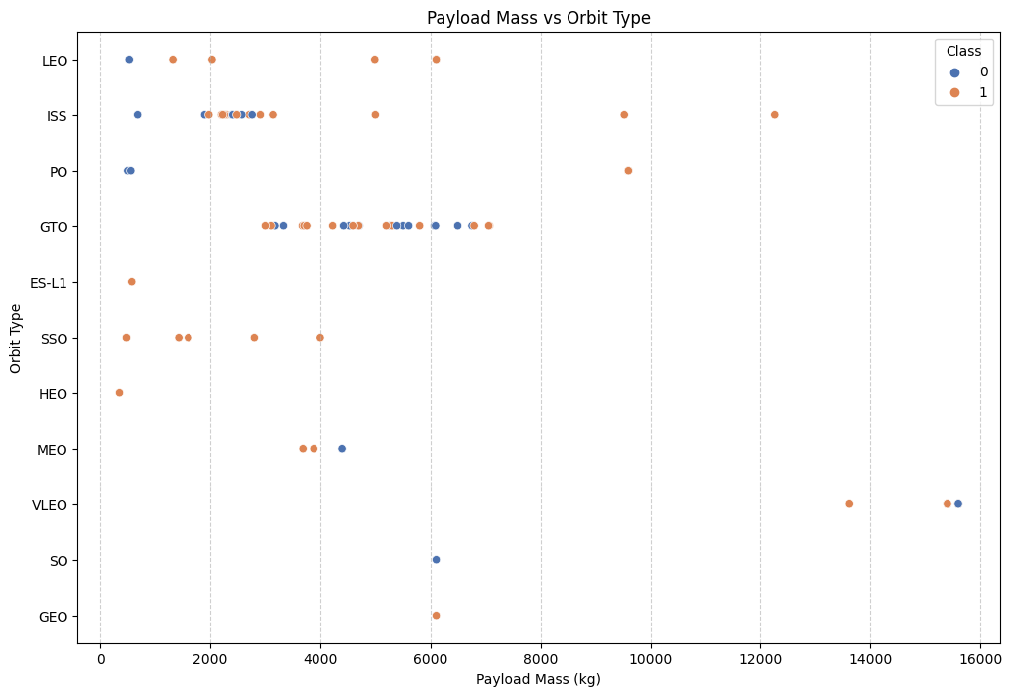
Payload vs. Orbit Type
This scatter plot visualizes the relationship between Payload and Orbit type.
We can observe that with heavier payloads, the successful landing rates are higher for Polar, LEO, and ISS orbits.
For the GTO orbit, the distinction is less clear as both successful and unsuccessful landings are observed for various payload masses.
This indicates that the success of a landing might be influenced by both the payload's weight and the intended orbit.

Slide 41
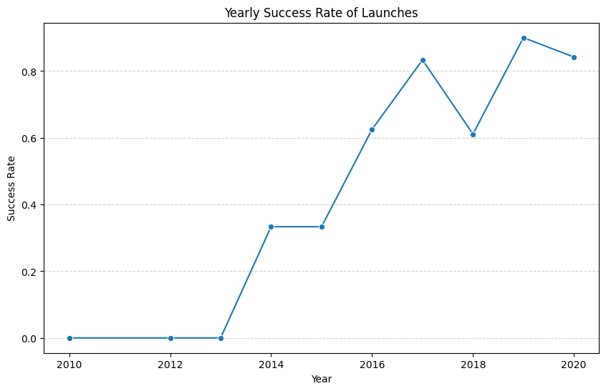
Launch Success Yearly Trend
This plot represents the trend in the average launch success rate over the years.
It allows us to understand how SpaceX's launch success rate has evolved over time.
By analyzing the trend, we can gain insights into the improvements or challenges faced by SpaceX in ensuring successful launches.

Slide 42
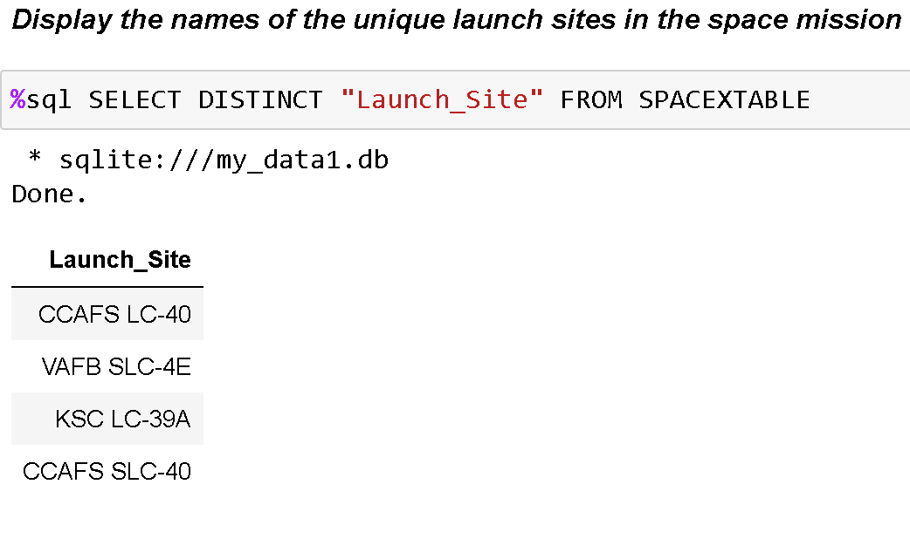
All Launch Site Names
%sql SELECT DISTINCT "Launch_Site" FROM SPACEXTABLE
Launch_Site CCAFS LC-40 VAFB SLC-4E KSC LC-39A CCAFS SLC-40
These launch sites represent the different locations from which SpaceX has conducted its launches, as recorded in the "SPACEXTABLE" table.

Slide 43
Launch Site Names Begin with 'CCA'
SELECT * FROM SPACEXTABLE WHERE "Launch_Site" LIKE 'CCA%' LIMIT 5;
Result
Launch_Site
CCAFS LC-40
CCAFS SLC-40
When using the LIMIT 5 clause in the query, it means the query will return at most 5 records that match the criteria. If there are fewer than 5 records that match as in this case, where only 2 records match, then only those matching records will be returned

Slide 44
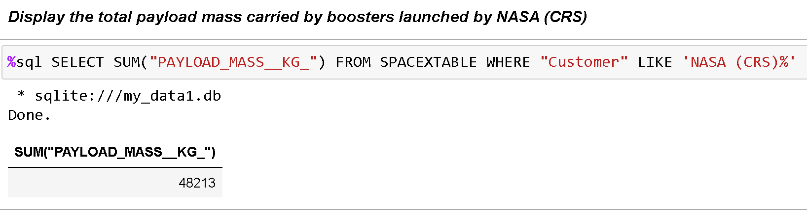
Total Payload Mass
The query filters the records in the SPACEXTABLE where the "Customer" column value starts with "NASA (CRS)". It then sums up the values in the "PAYLOAD_MASS__KG_" column

Slide 45
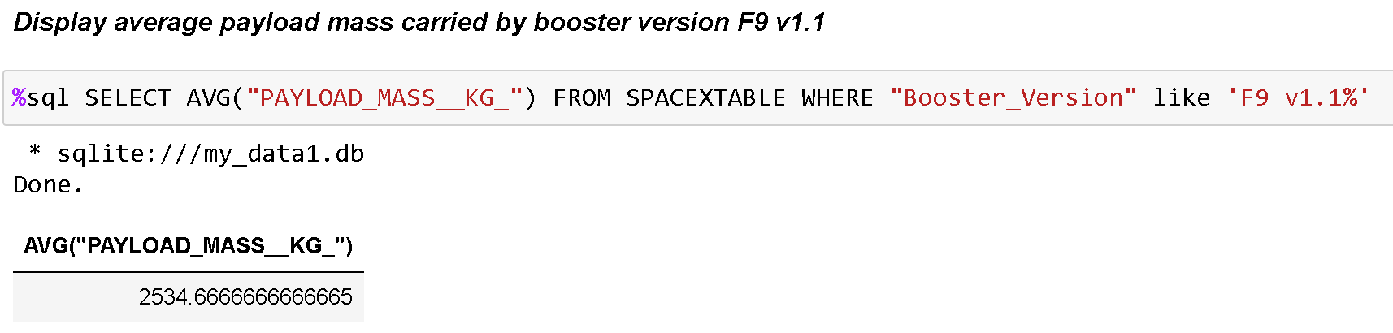
Average Payload Mass by F9 v1.1
%sql SELECT AVG("PAYLOAD_MASS__KG_") FROM SPACEXTABLE WHERE "Booster_Version" like 'F9 v1.1%'
The query shows that the booster version "F9 v1.1" has carried payloads with an average mass of approximately 2,534.67 kg.

Slide 46
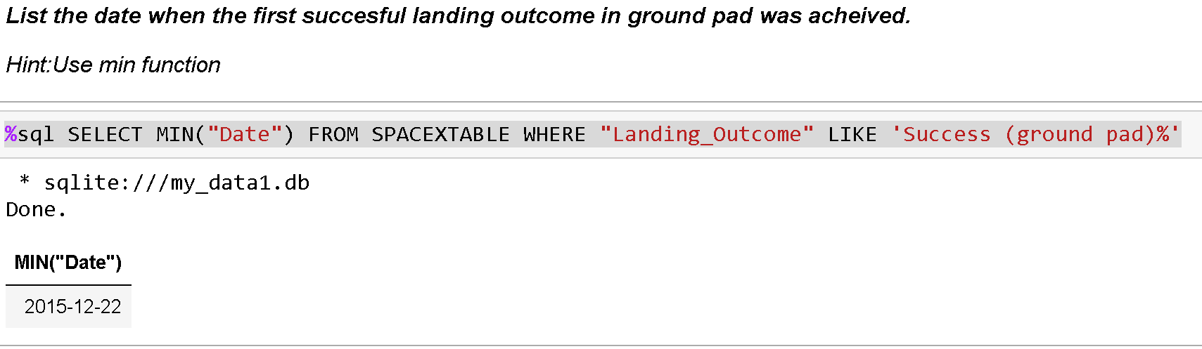
First Successful Ground Landing Date
%sql SELECT MIN("Date") FROM SPACEXTABLE WHERE "Landing_Outcome" LIKE 'Success (ground pad)%'
The query uses MIN("Date") to identify that SpaceX achieved its first successful landing on a ground pad on December 22, 2015

Slide 47
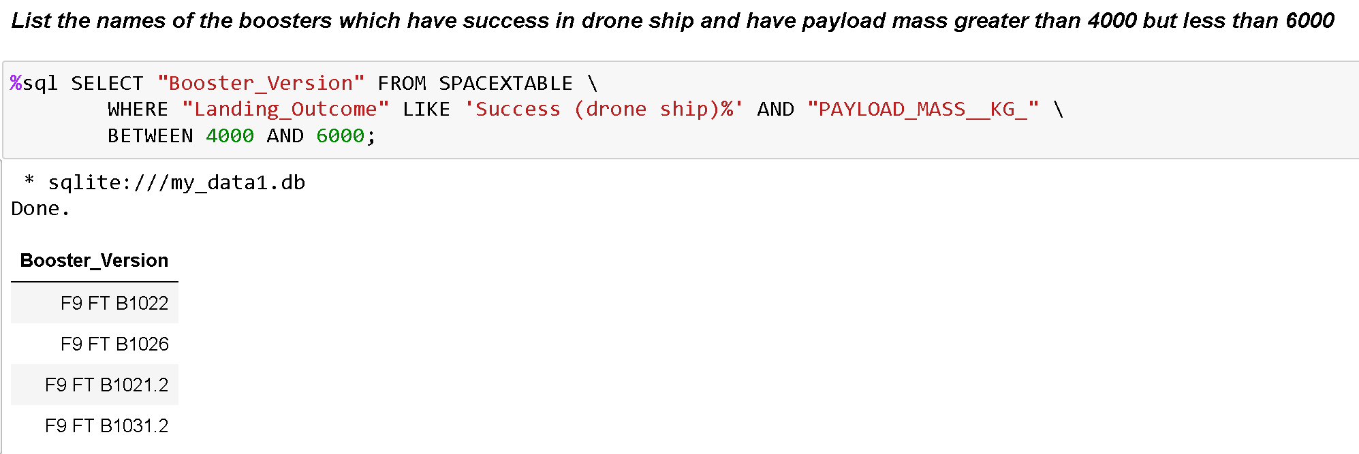
Successful Drone Ship Landing with Payload between 4000 and 6000
From the provided SpaceX dataset, it was identified that four booster versions (F9 FT B1022, F9 FT B1026, F9 FT B1021.2, and F9 FT B1031.2) successfully landed on a drone ship and carried payloads with a mass ranging between 4,000 kg and 6,000 kg. These booster versions highlight the capability of SpaceX's Falcon 9 Full Thrust boosters in safely landing on drone ships while carrying significant payload masses.

Slide 48
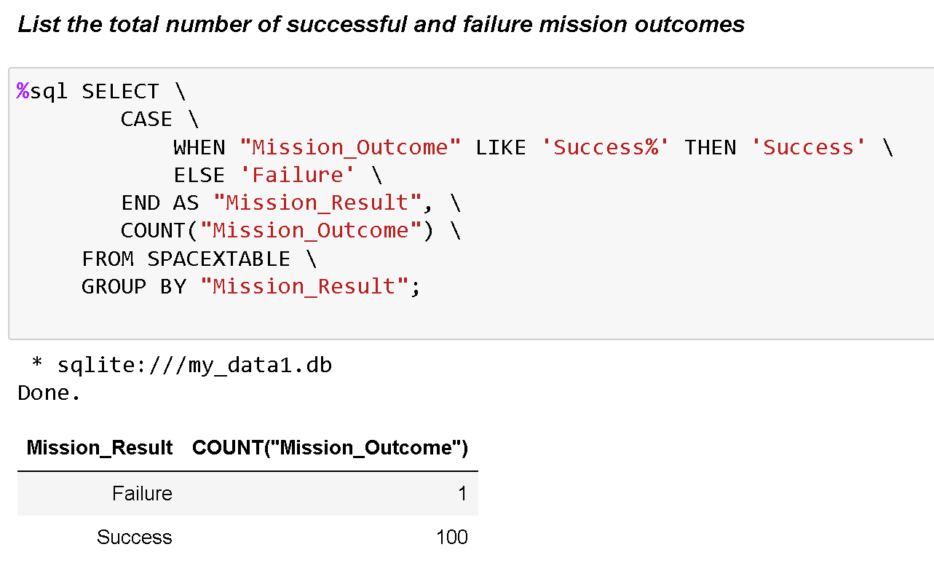
Total Number of Successful and Failure Mission Outcomes
%sql SELECT \ CASE \ WHEN "Mission_Outcome" LIKE 'Success%' THEN 'Success' \ ELSE 'Failure' \ END AS "Mission_Result", \ COUNT("Mission_Outcome") \ FROM SPACEXTABLE \ GROUP BY "Mission_Result";
Out of the missions recorded in the "SPACEXTABLE", 100 were successful, and only 1 was a failure. This showcases a high success rate for SpaceX missions.

Slide 49
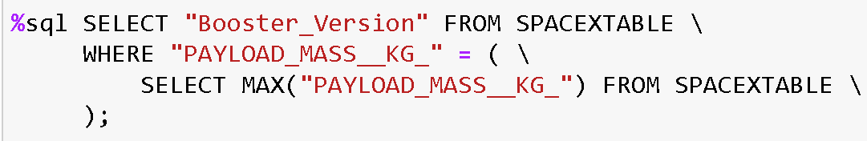
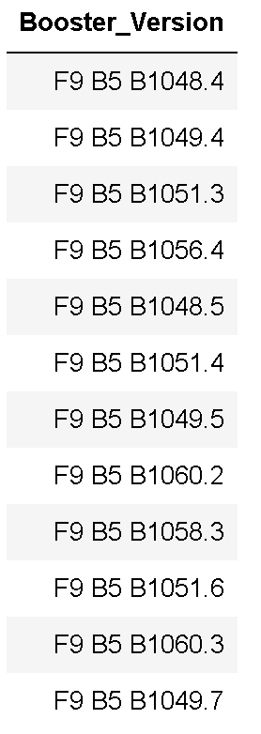
Boosters Carried Maximum Payload
%sql SELECT "Booster_Version" FROM SPACEXTABLE \ WHERE "PAYLOAD_MASS__KG_" = ( \ SELECT MAX("PAYLOAD_MASS__KG_") FROM SPACEXTABLE \ );
Booster_Version
F9 B5 B1048.4
F9 B5 B1049.4
F9 B5 B1051.3
F9 B5 B1056.4
F9 B5 B1048.5
F9 B5 B1051.4
F9 B5 B1049.5
F9 B5 B1060.2
F9 B5 B1058.3
F9 B5 B1051.6
F9 B5 B1060.3
F9 B5 B1049.7
The subquery SELECT MAX("PAYLOAD_MASS__KG_") FROM SPACEXTABLE determines the maximum payload mass from the entire "SPACEXTABLE".
The main query then selects the "Booster_Version" from the "SPACEXTABLE" where the "PAYLOAD_MASS__KG_" matches this maximum value.
Given that multiple booster versions have carried this maximum payload mass, the result lists all of these boosters. This indicates that several SpaceX booster versions have achieved the capability to carry the highest payload mass recorded in the table.
Notes:
List the names of the booster which have carried the maximum payload mass
Present your query result with a short explanation here

Slide 50
2015 Launch Records
Since sqlLite has no function to convert month number to month name, I must add a column to the DB with the month names.
query = "SELECT * FROM SPACEXTABLE" df = pd.read_sql(query, con) df['Date'] = pd.to_datetime(df['Date'])
Create a new column with month names df['month_name'] = df['Date'].dt.strftime('%B')
Upload the updated dataframe back into the SQL database then run the final query. df.to_sql('SPACEXTABLE', con, if_exists='replace', index=False)
%sql SELECT "month_name" AS Month, "Landing_Outcome", "Booster_Version", "Launch_Site" \ FROM SPACEXTABLE \ WHERE "Landing_Outcome" LIKE 'Failure (drone ship)%' AND substr("Date", 1, 4) = '2015';
The query identifies that in 2015, there were two SpaceX missions that attempted to land on a drone ship but unfortunately failed. Both of these missions launched from the CCAFS LC-40 site and used the F9 v1.1 booster versions.:
Month | Landing_Outcome | Booster_Version | Launch_Site
October | Failure (drone ship) | F9 v1.1 B1012 | CCAFS LC-40
April | Failure (drone ship) | F9 v1.1 B1015 | CCAFS LC-40
Notes:
List the failed landing_outcomes in drone ship, their booster versions, and launch site names for in year 2015
Present your query result with a short explanation here

Slide 51
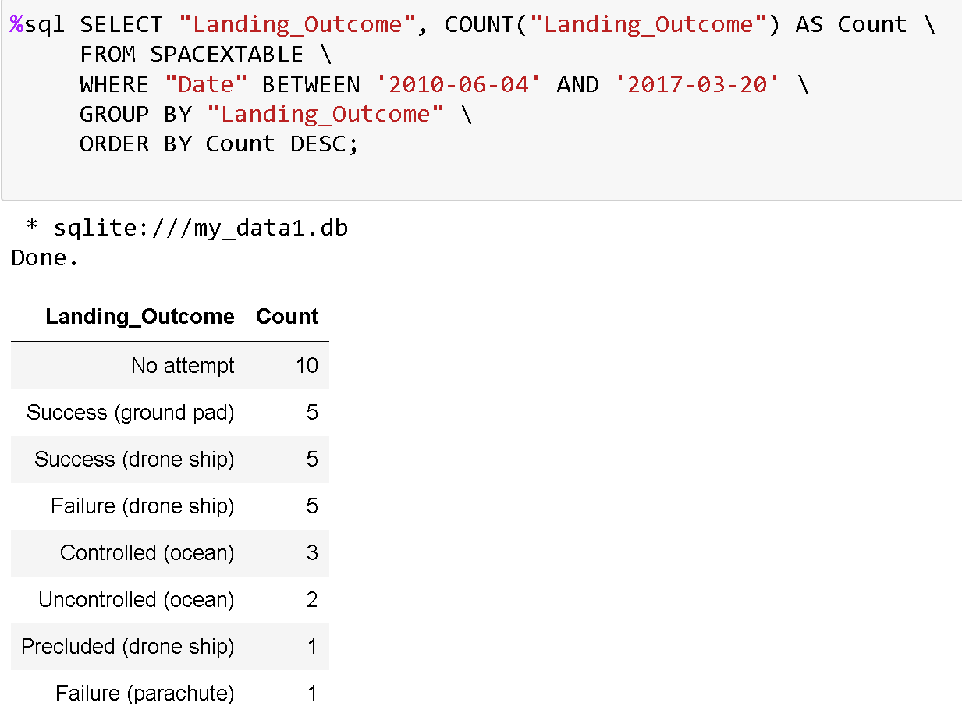
Rank Landing Outcomes Between 2010-06-04 and 2017-03-20
%sql SELECT "Landing_Outcome", \ COUNT("Landing_Outcome") AS Count \ FROM SPACEXTABLE \ WHERE "Date" BETWEEN '2010-06-04' AND '2017-03-20' \ GROUP BY "Landing_Outcome" \ ORDER BY Count DESC;
The query provides a ranked overview of SpaceX's landing outcomes for missions between June 4, 2010, and March 20, 2017. The most common outcome was "No attempt" with 10 occurrences
GitHub Folder - Hands-on Lab - Complete EDA with SQL

Slide 52

Section 3

Slide 53
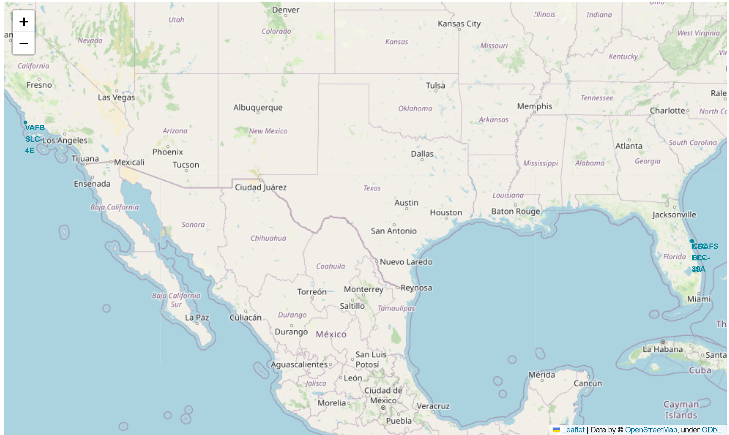
Launch Site Locations
None of SpaceX's launch sites are close to the Equator. launch sites near the Equator benefit from Earth's rotation.
Launch sites are located on the coasts to ensure rockets' trajectories are over open water, minimizing risks to populated areas in case of launch failures.
Coastal sites also offer flexibility in choosing launch directions, essential for different satellite orbits.
Being near coasts facilitates the transportation of large rocket components, by sea.

Slide 54
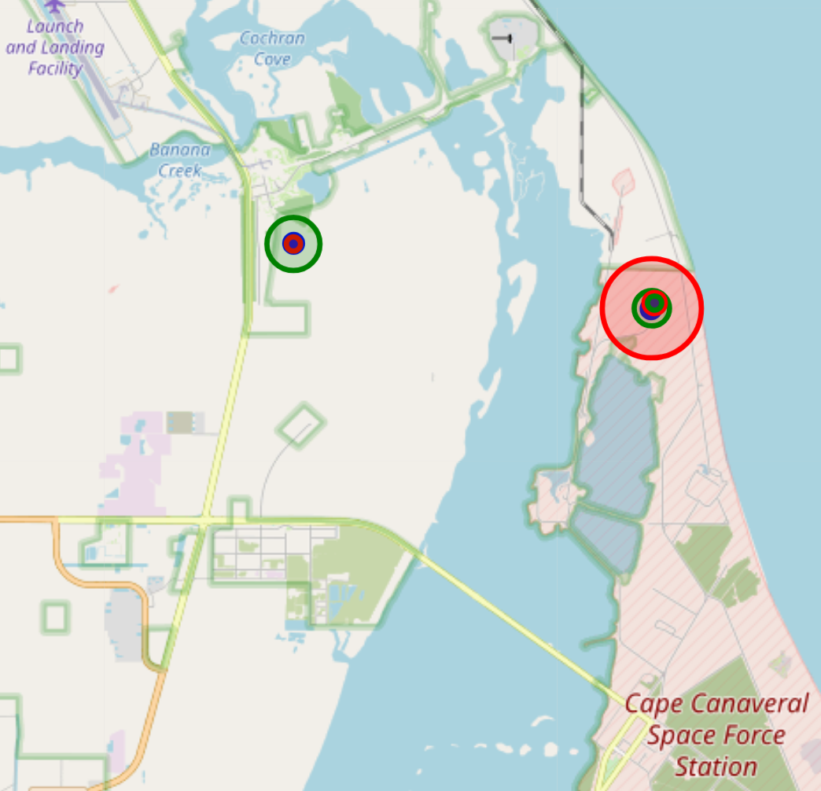
SpaceX Launch Outcomes by Site
Blue Markers: These represent the locations of SpaceX launch sites. The presence of a blue marker at 'Cape Canaveral Space Force Station' indicates it's one of the launch sites.
Green Circles: These denote successful launches. The size of the circle corresponds to the number of successful launches; a larger circle indicates more successful launches.
Red Circles: These denote launch failures. The size of the circle relates to the number of failed launches; a larger circle indicates more failures.
By observing the size and color of the circles around 'Cape Canaveral Space Force Station', one can gauge the success rate and volume of launches, giving insights into the performance and reliability of launches from that specific site

Slide 55
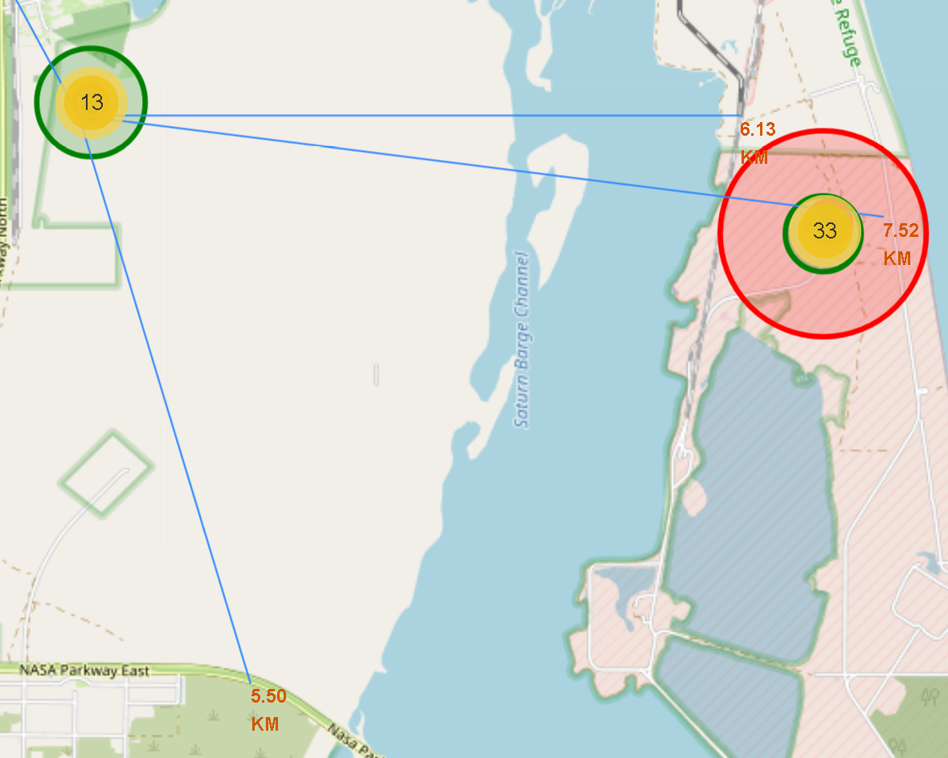
Launch site Proximity to Highway, Rail and Coast
Launch sites being near railways, roads and coastlines implies logistical convenience. Railways, major roads and Coastlines facilitate easier transportation of heavy and large rocket components. In addition Proximity to coastlines, offers safety (trajectory over water) and flexibility in launch azimuths.
Being away from cities is a safety measure. In case of launch anomalies or failures, risks to populated areas are minimized.

Slide 56

Section 4

Slide 57
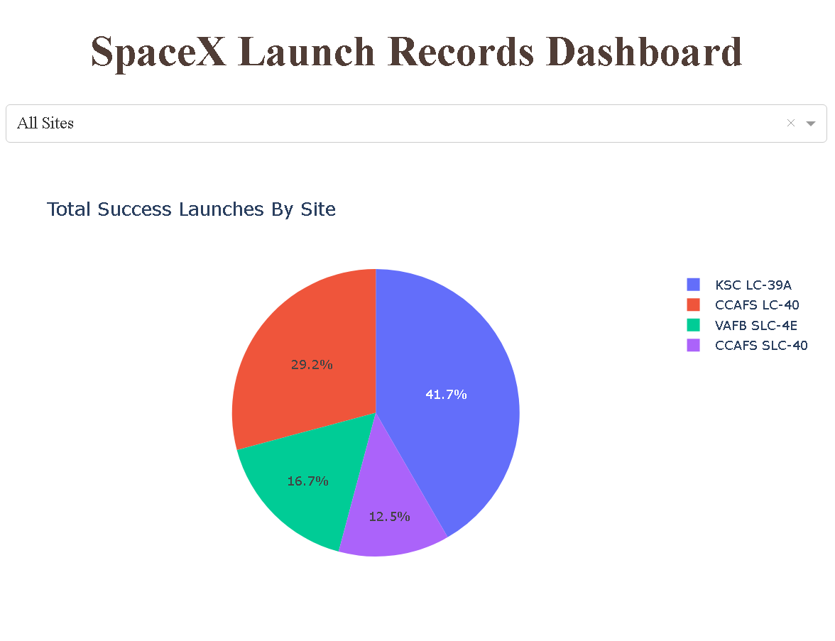
Total Successful Launches for All Sites
The pie chart provides a breakdown of the total successful launches for each launch site.
Each segment of the pie chart represents a different launch site, with the site's name and the count of successful launches displayed.
Provides an overview of the success distribution across all launch sites.

Slide 58
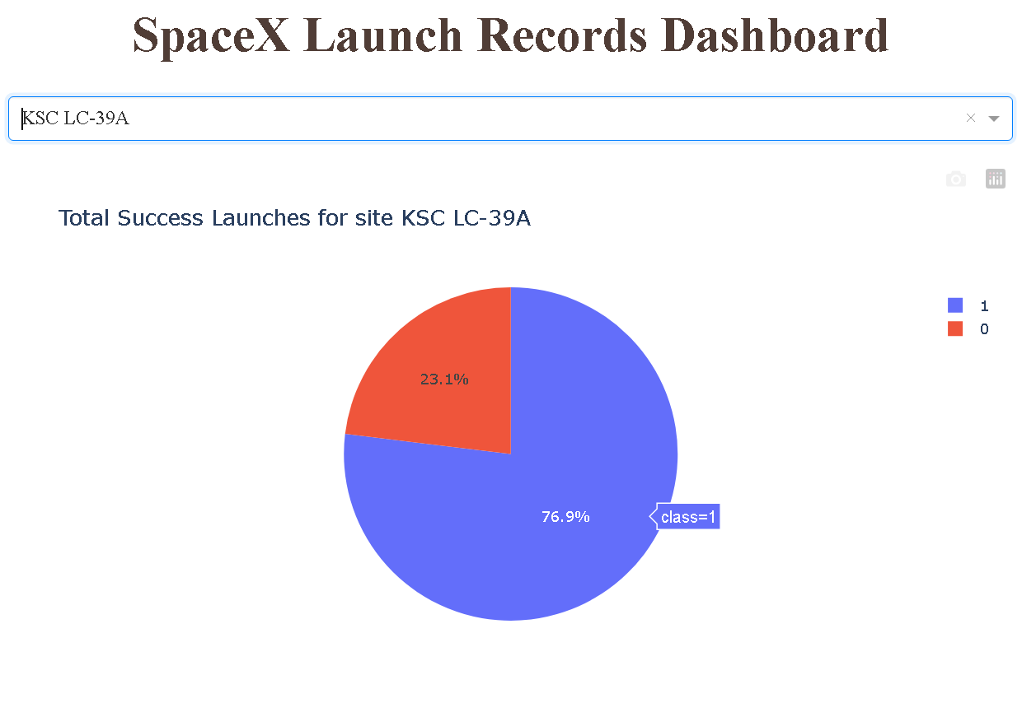
With Most Successful Launch Site
High Success Rate: "KSC LC-39A" has a notable success rate, as indicated by its success ratio. This suggests that launches from this site have been largely successful, making it a reliable site for SpaceX.
Notes:
Replace <Dashboard screenshot 2> title with an appropriate title
Show the screenshot of the piechart for the launch site with highest launch success ratio
Explain the important elements and findings on the screenshot

Slide 59
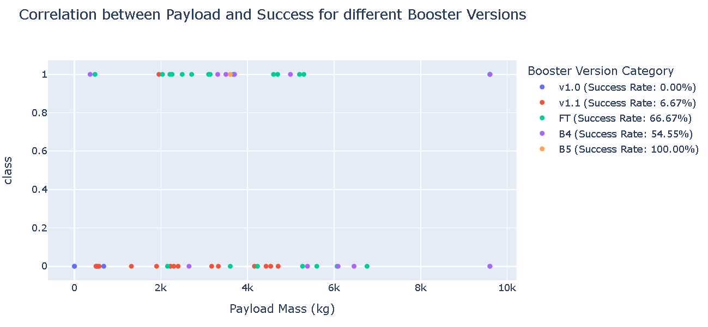
Payload Success Vs Booster Version
The Booster Version B5 is the most successful across all launch sites.
Launches carrying payloads in the range of 7,500 kg to 10,000 kg tend to have higher success rates.
KSC LC-39A: This launch site has the highest success rate at approximately 76.92%.
Notes:
Show screenshots of Payload vs. Launch Outcome scatter plot for all sites, with different payload selected in the range slider
Explain the important elements and findings on the screenshot, such as which payload range or booster version have the largest success rate, etc.

Slide 60

Section 5

Slide 61
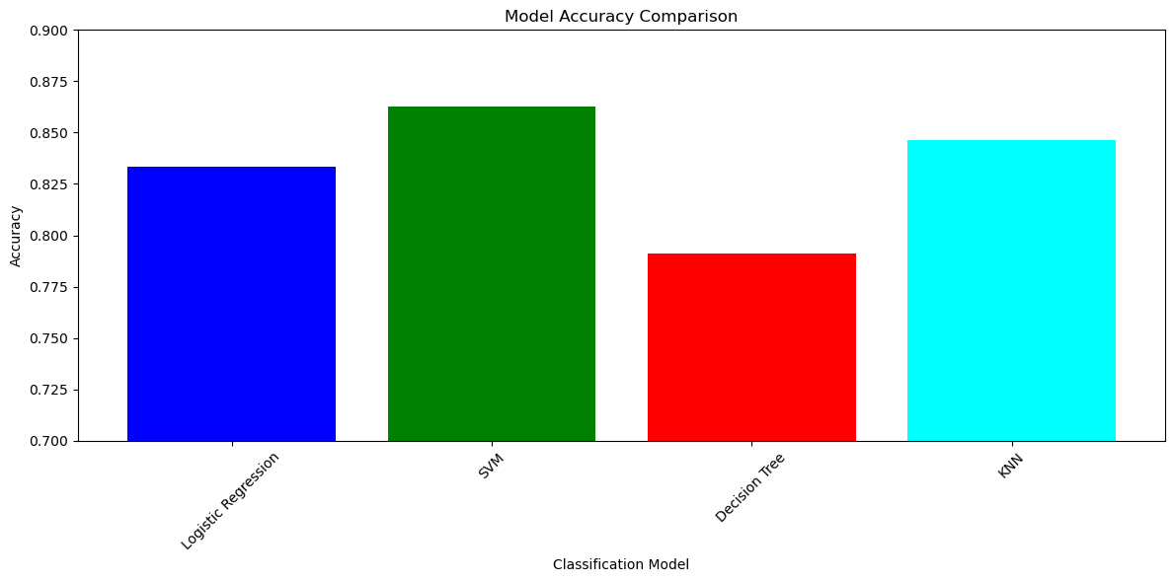
Classification Accuracy
SVM has the highest accuracy at 86.25%.
Logistic Regression follows with 83.33%.
KNN is next with an accuracy of 84.64%.
Decision Tree has the lowest accuracy at 78.93%.
Notes:
Visualize the built model accuracy for all built classification models, in a bar chart
Find which model has the highest classification accuracy

Slide 62
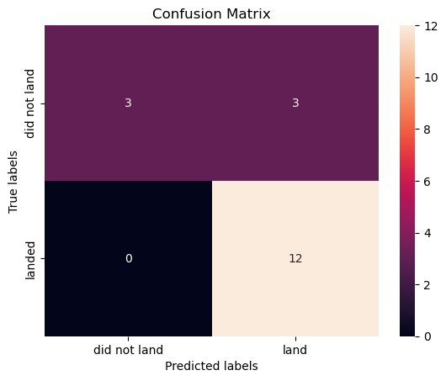
Confusion Matrix for SVM
Confusion Matrix Results:
True Positives: The model correctly predicted 3 rocket landings.
True Negatives: The model never correctly predicted when a rocket wouldn't land.
False Positives: The model incorrectly forecasted 3 landings that didn't happen.
False Negatives: The model missed 12 actual landings, predicting they wouldn't land.
Implications:
The model is fairly accurate at predicting when rockets will land.
However, it struggles to correctly predict when rockets won't land.

Slide 63
Conclusions
Confusion Matrix Results:
True Positives (3): This indicates that, the actual outcome (rocket landing) and the model's prediction aligned perfectly.
True Negatives (0): The absence of true negatives (a value of 0) suggests that the model has challenges accurately identifying situations where the rocket will not land.
False Positives (3): These are instances where the model predicted a rocket landing, but in reality, the rocket did not land. This implies that, in three cases, the model was overly optimistic, anticipating successful landings when they did not occur.
False Negatives (12): A high number of false negatives suggest that the model was quite conservative or cautious. In twelve instances, the model predicted that the rocket would not land successfully, when, in fact, they did. This could be viewed as the model erring on the side of caution. This is very desirable because rocket mistakes cost a lot of money
In summary
Given the high cost and risks associated with rocket launches, the model's inclination towards false negatives (erring on the side of caution) can be seen as a safety measure, anticipating potential failures even when they don't occur.
The model's primary strength lies in its conservative approach, signaling alerts even when things go right.
In high-stakes space industry, caution can be crucial, as it ensures safety and prevents potential losses.

Slide 64
Appendix
All relevant assets are included in the GitHub Repository link below including :
SQL queries and CSV data set Files
Charts and Images
Notebooks and Python code
Applied-Data-Science-Capstone
Applied-Data-Science-Capstone
https://github.com/jeremyharkness/Applied-Data-Science-Capstone

Slide 65


